Slide 1
The Study App
Milestone 1
Team Justice League
Joan Sirma
Jeffrey Woo
Vishal Ravuri
Soneer Sainion
Manisha Yalavarthy
Notes:
*Jeff

Slide 2
What is the Study App?
An application that offers lessons and notes to students for an array of subjects such as Calculus, Physics and Computer Science
Allows input from instructors in order to expand upon the information submitted
Community sourced - by students, FOR students
Students provide content (ex. notes, videos, quizzes) that others can access
Instructors can gain access to restrict certain content, such as active exam uploads
Notes:
*Jeff
Introduction to what the application is and its benefits (which will be continued on the next slide)

Slide 3



Rationale
SIMILAR APPLICATIONS (but not quite ours …)
This application allows students to be able to have access to course materials, study guides and notes as well as the ability to find help from other students.
In essence, this is a focused content provider. It is tailored to a specific class, not a book, not a generic set of slides. Professor X talks about Y which is analogous to book Z, that is the type of information that is seldom accessible. TheStudyApp seeks to rectify that.
Canvas
Quizlet
Chegg
Notes:
*Joan
1.Why is this app needed and how can it help others
2.Talk about some features of the “competitors”
Canvas:Allows professors to have a platform for assignment and projects and students have access and ability to start discussions
Quizlet: Allows you to find flashcards created by other users for a variety of subjects
Chegg: Allows online support for homework for different subjects
3.How is our application different ?

Slide 4
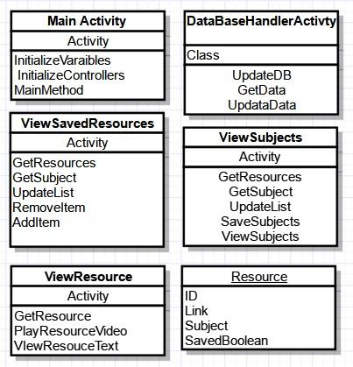
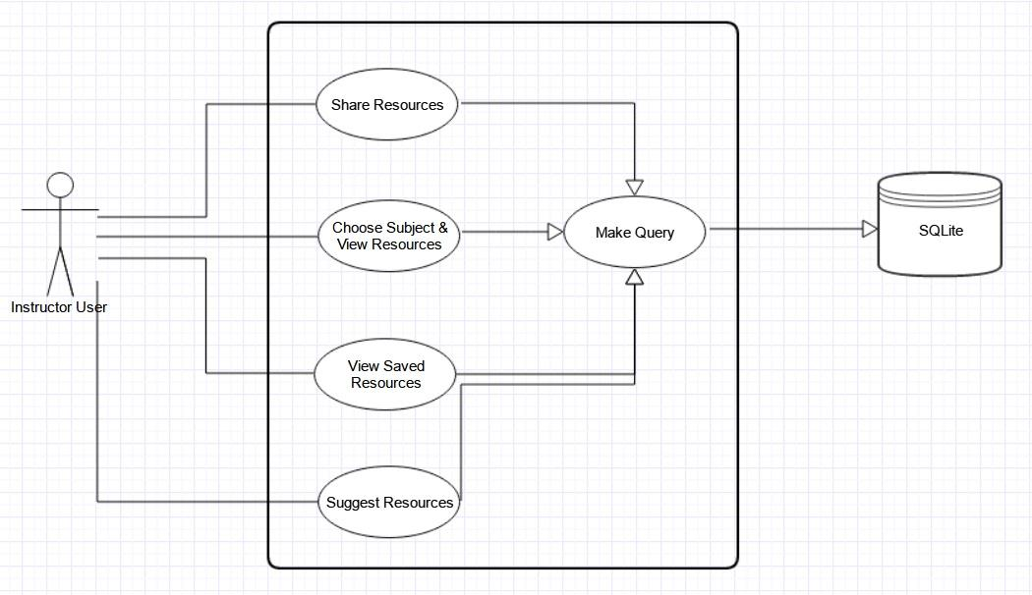
Architecture and Design
Class Diagram
Instructor UML Diagram
Notes:
*Joan or Manisha
Class Diagram : Discuss the different classes and their purpose
UML Diagram , we have two one for the student and for the instructor (the above is for instructor) which shows a general flow to
What the instructor/students will have and how we can connect to the database (which we will talk about in the demo)
(Note that the student diagram would be similar to the instructors )

Slide 5
Testing
Stress Testing
Must be able to handle data for multiple users
Be able to sync and load data for users and subjects
Bug Testing for UI
UI needs to be functional, user friendly and intuitive
Tested for glitches and defects
Accessibility integration for multimedia devices/media
Social media implementation
Notes:
*Manisha
Talk about the different test cases we might use to ensure the functionality of the application is smooth.
Test cases on android that check our pass/fail criterias as well as assumptions and constraints

Slide 6
Risks
Lack of content
A lack of involvement means the app is essentially DOA
Too much content
Unabated mass uploads would require too much storage capacity
Rights
If a professor does not want to have their content released
Instructor Involvement
Defeats the purpose of the app providing expanded office hours
Notes:
*Vishal

Slide 7
DEMO
Notes:
*Soneer
Show key features of what we have working so far

